Slide 1
Evaluating regression model performance & their selection

Slide 2
R square intuition
y
Simple linear regression
  SS_{res}=Sum (y-y’)²→ min
Lets draw the average line instead of regression line
  SS_{tot} = Sum(y-y_{avg})2→min
R² = 1- SS_{res}/SS_{tot}
R² is normally between 0 and 1, however R² can be negative also
R² gives how well your model is fitted to the data
  In fact how much model is fitted than the average line that can be fitted to the data easily.
x
y
y_{avg}
x

Slide 3
R square intuition
R² = 0 (fitted model is equally good as average line)
R² = 1 (SS_{res} =0 -> ideal scenario)
R² <0 (if your simple linear model fits the data worse than the average line)
R²--> goodness of fit (greater is better)

Slide 4
Problem in R²
The same concept apply to multiple linear regression
  SS_{res} -> min
Problem
  Y = b₀ + b₁*x₁ + b₂*x₂
  You want to check the impact of a new independent var x3 on the model ( model gets better or not (accuracy improves or not))
  Y = b₀ + b₁*x₁ + b₂*x₂ + b₃*x₃
R² will never decrease
  If x₃ will help in minimizing SS_{res}-> regression process will find a way to give a coefficient b₃ that will help to minimize SS_{res} then R² will increase
  If x₃ has not correlation with dependent var, regression process will make its coefficient 0, then R² will not change
    (rarely happens - There can always be at least a slight random correlation between independent var and dependent var thus R2 will insignificantly increase in this case also).

Slide 5
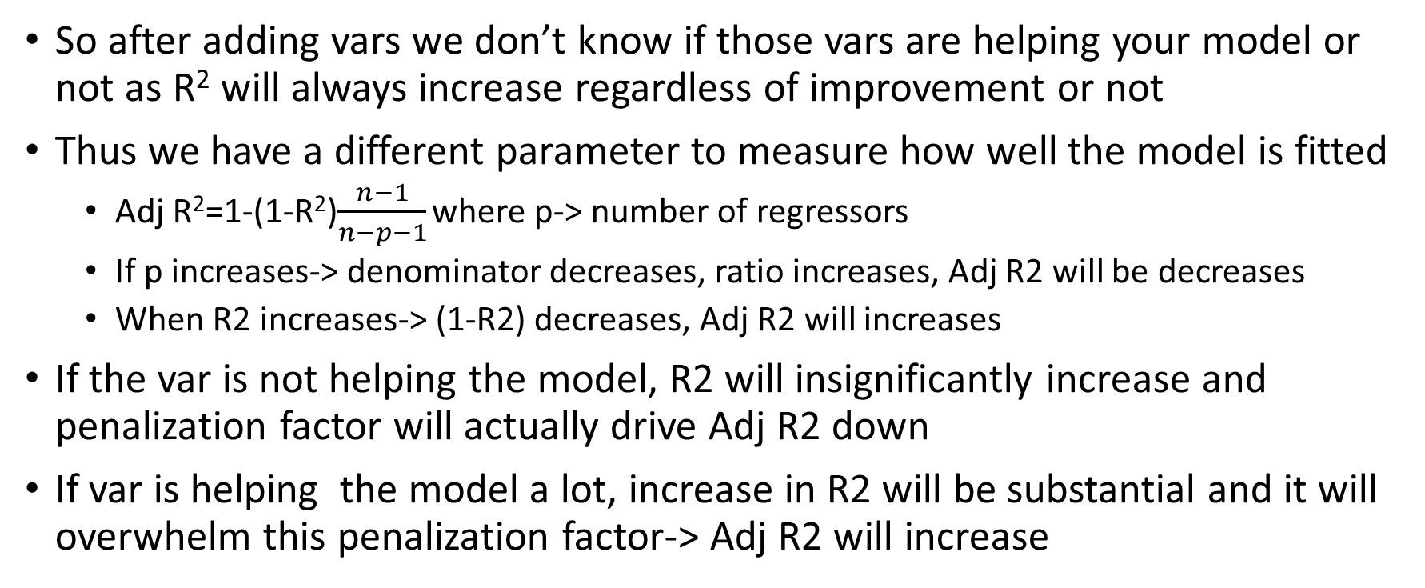
Adjusted R²
So after adding vars we don’t know if those vars are helping your model or not as R² will always increase regardless of improvement or not
Thus we have a different parameter to measure how well the model is fitted
  Adj R²=1-(1-R²)$\frac{n−1}{n−p−1}$ where p-> number of regressors
  If p increases-> denominator decreases, ratio increases, Adj R2 will be decreases
  When R2 increases-> (1-R2) decreases, Adj R2 will increases
If the var is not helping the model, R2 will insignificantly increase and penalization factor will actually drive Adj R2 down
If var is helping the model a lot, increase in R2 will be substantial and it will overwhelm this penalization factor-> Adj R2 will increase

Slide 6
Evaluating the Model Performance
from sklearn.metrics import r2_score
r2_score(y_test, y_pred)

Slide 7
Pros and Cons
Regression Model | Pros | Cons
Linear Regression | Works on any size of dataset, gives information about relevance of features | The Linear Regression Assumptions
Polynomial Regression | Works on any size of dataset, works very well on non linear problems | Need to choose the right polynomial degree for a good bias/variance tradeoff
SVR | Easily adaptable, works very well on non linear problems, not biased by outliers | Compulsory to apply feature scaling, not well known, more difficult to understand
Decision Tree Regression | Interpretability, no need for feature scaling, works on both linear / nonlinear problems | Poor results on too small datasets, overfitting can easily occur
Random Forest Regression | Powerful and accurate, good performance on many problems, including non linear | No interpretability, overfitting can easily occur, need to choose the number of trees

